Slide 1


Premier League Web scraping
Milan

Slide 2
Introduction
A program that scrapes the Premier League website and stores stats from every game played in the premier league since the 2011-12 season.
The main source used was the Premier League website, with each result being scraped from a new URL depending on the match id.
The data set in stored in CSV file and SQL tables.

Slide 3
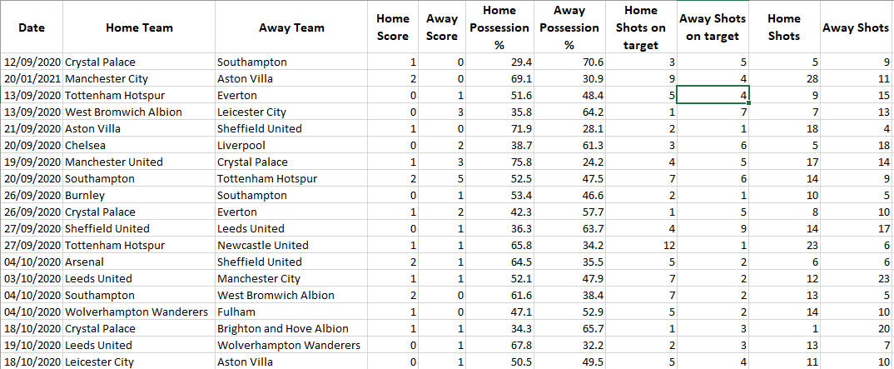
Data Set
Results of the 2020-21 season stats

Slide 4
Data Set
The data set contain the results and the stats of the premier league games corresponding to the season. This contains details of the matches including the results, score, possessions, shots, shots on target, passes and many more.
The reason for collecting such detailed stats is to feed the data into a machine learning model in order to predict the results for the next season.

Slide 5
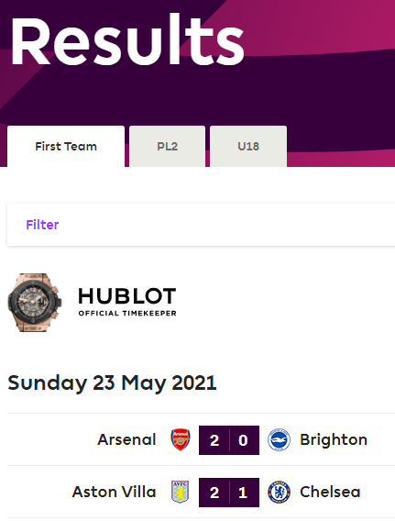
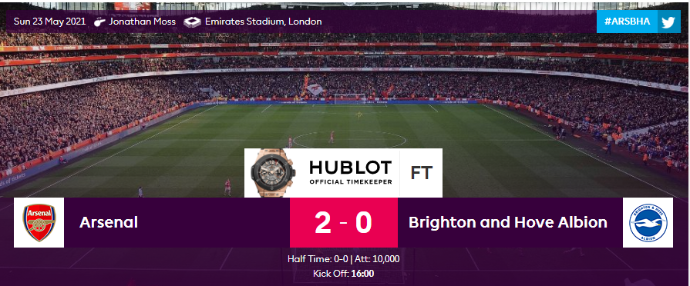
Sources
https://www.premierleague.com/results?co=1&se=363&cl=-1
https://www.premierleague.com/match/59266

Slide 6
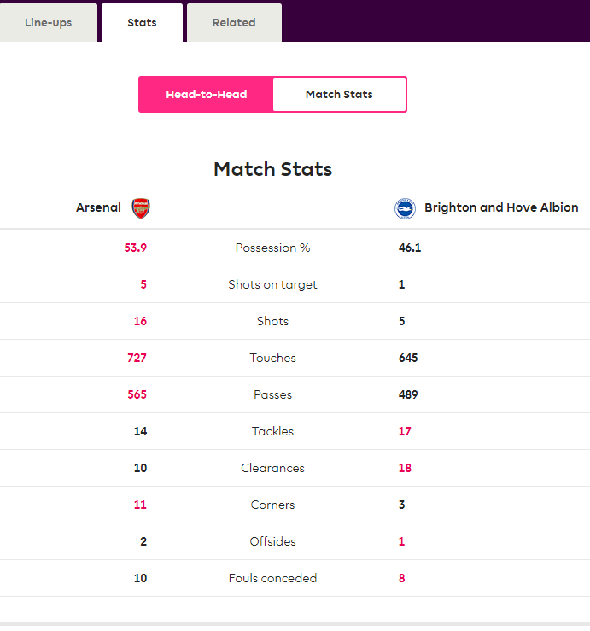
Sources
https://www.premierleague.com/match/59266
I used the season and the range of the match id’s in a dictionary to get the relevant URL code.
From the resulting page, I scraped the date, the team names and the scores using the xpath.
In order to scrape the stats of the game, I used Selenium to enable me to select the stat details.

Slide 7
Data
CSV
SQL
The data was saved in CSV format
This meant it was quicker to parse the data, and also took up less space.
I used row by row updating rather than bulk updating.
CSV is also easy to import into a SQL table.
CSV data was written into a SQL table
This helps in easy maintenance, quick data recovery and easy to query.
I can use this table to feed data into a Machine Learning model

